Slide 1


Retail performance & Revenue insights Report Analysis of Sales Trends, Customer Behavior and Geographic Demand
Prepared For CEO & CMO
Prepared By Uzair Khan
2/15/2026

Slide 2
Introduction
01

Slide 3
Analysis of Sales Trends ,Customer Behavior and Geographic Demand
Situation:
Retail sales performance varies across time, regions, and customers.
Complication:
Lack of clear understanding of revenue drivers limits strategic decision-making.
Key Question:
Where should the business focus to maximize revenue growth?
Key Insight:
Revenue is driven by top markets, high-value customers, and seasonal demand trends.

Slide 4
Executive summary
01
Argument 1
Market & Regional Revenue Performance
02
Argument 2
Customer Revenue Contribution

Slide 5
Market & Regional Revenue Performance
Task 01

Slide 6
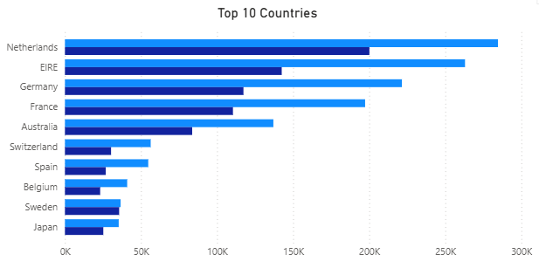
Regional Demand Drives Revenue Growth
European markets are the primary drivers of global retail revenue.
Netherlands generates highest revenue contribution
Ireland and Germany follow as strong performing markets
Europe dominates global demand concentration
Other regions show growth potential but lower revenue share

Slide 7
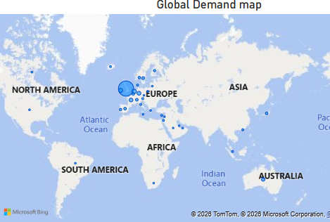
Global Demand Distribution
Revenue demand is highly concentrated geographically
Strong customer demand is visible across European region
Limited demand concentration observed in Asia and South America
Geographic expansion presents opportunity for revenue growth
Current market reliance increases business risk

Slide 8
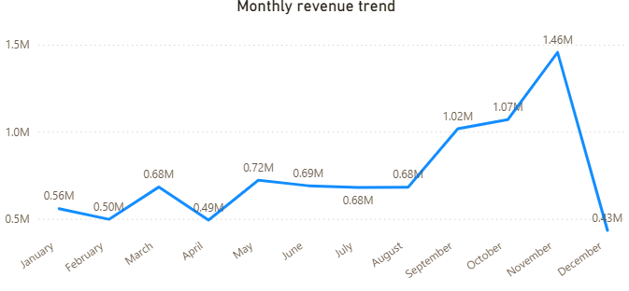
Monthly Revenue Growth Trend
Revenue increases significantly in the second half of the year.
Content:
Revenue steadily grows from early months into Q4
November records highest monthly revenue performance
December shows decline indicating seasonal volatility
Peak periods present opportunity for promotional planning

Slide 9
Customer Revenue Contribution
Task 02

Slide 10
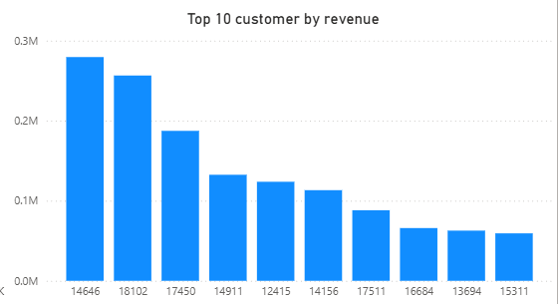
Revenue Is Concentrated Among Top Customers
A small group of customers generates the majority of retail revenue.
Content:
Top customers contribute significantly higher revenue than average
Revenue declines sharply beyond top tier customers
Indicates strong loyalty but high dependency risk
Customer diversification can improve revenue stability

Slide 11
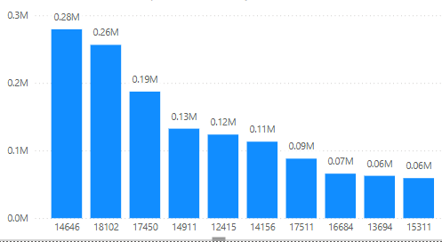
Customer Revenue Distribution Analysis
Customer spending behavior reveals growth and retention opportunities.
Content:
Highest revenue customer contributes nearly double compared to lower tier customers
Customer spending pattern highlights premium buyer segment
Mid-tier customers represent expansion opportunity
Customer retention strategies can improve revenue consistency

Slide 12
Final Recommendation / Conclusion
03

Slide 13
Strategic Revenue Growth Recommendation
Expand high-performing markets while reducing dependency on limited customers.
Market Expansion Strategy
Increase investment in Netherlands, Ireland, and Germany
Expand operations in emerging international markets
Seasonal Revenue Optimization
Strengthen marketing during high-performing months
Improve inventory planning for peak demand
Customer Diversification Strategy
Develop retention programs for top customers
Introduce targeted promotions for mid-tier customers
Expand customer acquisition strategies

